Slide 1
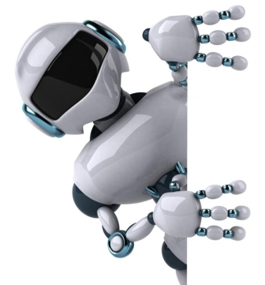
Creation of models of robots in human growth (MadScale.com)
We offer an exclusive service, unprecedented on the interior market. In fact, it is a modern sculptural art.
mail@madscale.com
Growth: 180 cm (available higher or shorter).
Weight: 20 kg.
Material: fiberglass.
Assembly takes 10 minutes.
Period of creation: 1 item - 35 days, 10 - 45 days, 20 - 60 days.
Can be created a model on the layout of the customer.
Cost (it is about quantity of the copies of one robot):
1 robot – 5000$/item, 10 robots – 2800$/item, 20 robots – 2500$/item.

Slide 2
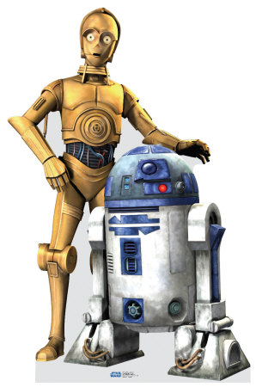
C3PO - A replica of the robot in a human growth.
R2D2 - A replica of the robot in 1:1 scale (96 cm)

Slide 3
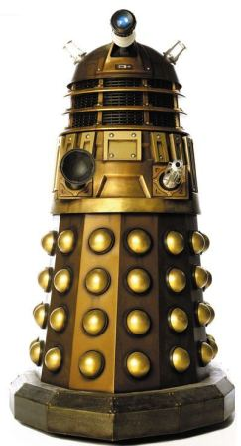
DALEK - A replica of the robot in a human growth.
Imagine the surprise of your guests when they see the known model of the robot in a human growth in your hallway.

Slide 4
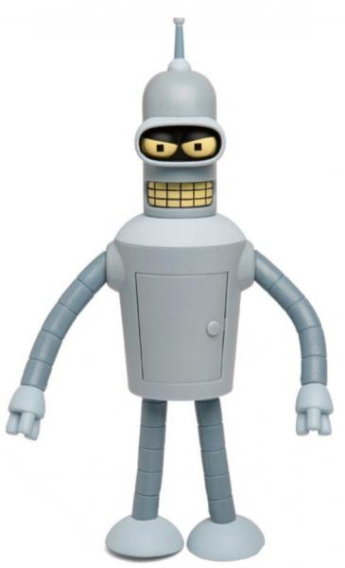
BENDER - A replica of the robot in a human growth.
Or in a country house, you can put two robots at the entrance, as if they are some guards.

Slide 5
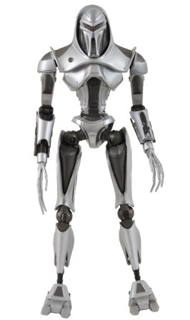
CYLON - A replica of the robot in a human growth.
Before people put lions and angels. And now you can put the perfect robots.

Slide 6
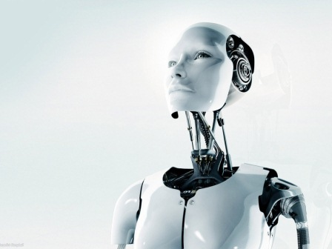
Model of a ROBOT IN a HUMAN GROWTH
It can be either good natured and friendly, or warlike.

Slide 7
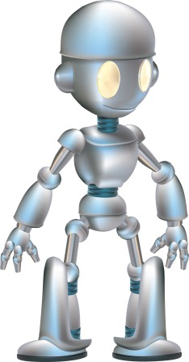
Model of a ROBOT IN a HUMAN GROWTH
Who needs these models:
Shopping center,
- Kindergarten, school, university

Slide 8
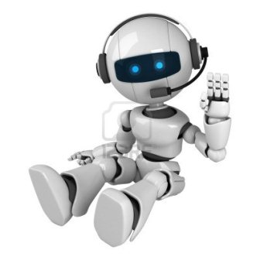
Model of a ROBOT IN a HUMAN GROWTH
Who needs these models:
Children's Playground,
- Motor Shows

Slide 9
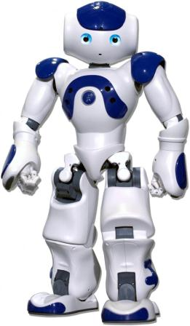
Model of a ROBOT IN a HUMAN GROWTH
Who needs these models:
- IT and other companies that can place an impressive breadboard model on the front of the office

Slide 10
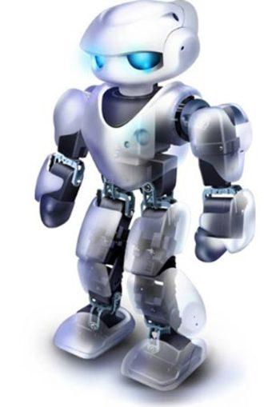
Model of a ROBOT IN a HUMAN GROWTH
Who needs these models:
Exhibits,
- For home, cottage interior

Slide 11
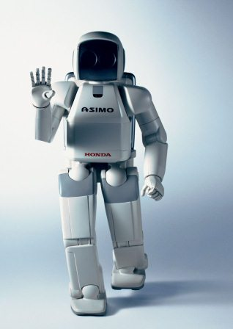
Model of a ROBOT IN a HUMAN GROWTH
Who needs these models:
- Robotics fans or certain models of robots, including the movies.

Slide 12
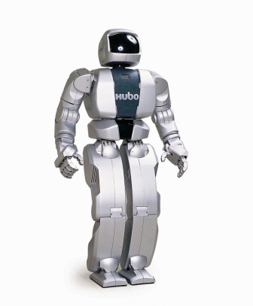
Model of a ROBOT IN a HUMAN GROWTH
Our models is a work of art, no worse than known sculptures.

Slide 13
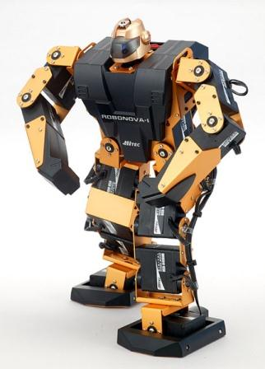
Model of a ROBOT IN a HUMAN GROWTH
In addition to these robots, can be produced models according to client’s design.
Animals, dinosaurs.

Slide 14
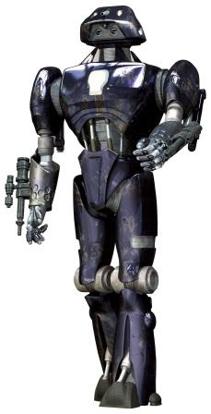
Model of a ROBOT IN a HUMAN GROWTH
Growth: 180 cm (available higher or shorter).
Weight: 20 kg.

Slide 15
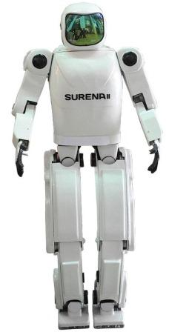
Model of a ROBOT IN a HUMAN GROWTH
Material: fiberglass. Prefabricated structures, assembly takes 10 minutes.

Slide 16
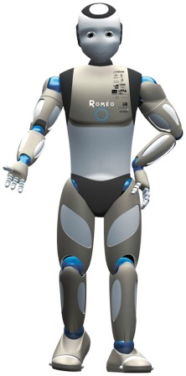
Model of a ROBOT IN a HUMAN GROWTH
Models are hollow, that is, they can not move or show any interaction with the user.

Slide 17
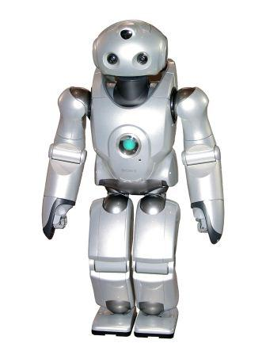
Model of a ROBOT IN a HUMAN GROWTH
However, clients can separately discuss the possibility of creating the look of burning eyes, the movement of the jaws, eyes, head, hands etc.

Slide 18
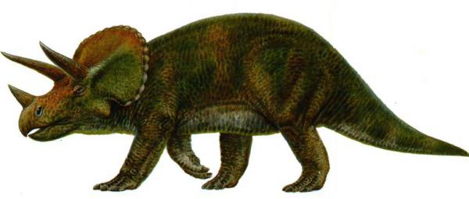
Model of a DINOSAURS IN a real scale
Also we create robotic dinosaurs in life-size according to our designs or customer’s design (that is, even the fabulous animals. For example, from the Star Wars).
The cost depends on the size and functionality. For example, this model of triceratops (the size of a cow) is worth $28000, which is 12 times cheaper then counterparts.

Slide 19
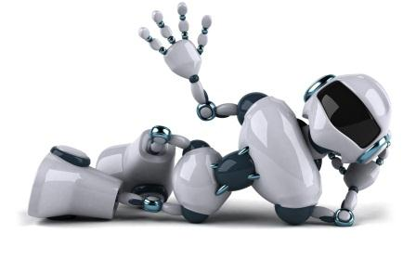
Creation of models of robots in human growth (MadScale.com) Retailers: place this offer on your site, redirect orders to us and get 5% of the order value.
We offer an exclusive service, unprecedented on the interior market. In fact, it is a modern sculptural art (mail@madscale.com).
Growth: 180 cm (available higher or shorter).
Weight: 20 kg.
Material: fiberglass.
Assembly takes 10 minutes.
The basic cost refers to hollow and static models.
Period of creation: 1 item - 35 days, 10 - 45 days, 20 - 60 days.
Can be created a model on the layout of the customer.
Cost (it is about quantity of the copies of one robot):
1 robot – 5000$/item, 10 robots – 2800$/item, 20 robots – 2500$/item.
The following is a list of components that can be installed in a robot.

Slide 20
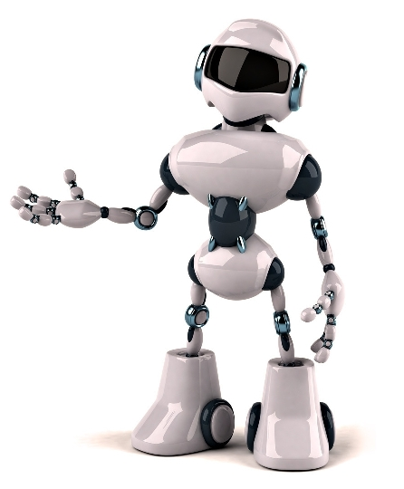
List of robot’s components
Note:
- Delivery and installation: i.e. shipping from the manufacturer of the component - to the plant and assembly.
- All components can be installed at the same time, so the delivery time and the installation does not add up, if you select multiple components. To install all components from this list does not take more than 40 days.
- In all cases, the power supply: 100 - 240 volts at 50 Hz.

Slide 21
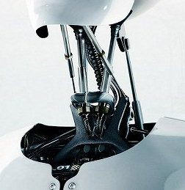
Components of robot
Head movement only in the vertical
Up and down.
Delivery and installation - 15 days.
1584 $.

Slide 22
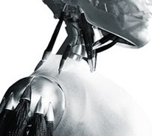
Components of robot
Head movement only horizontally
Right and left.
Delivery and installation - 15 days.
1584 $.

Slide 23
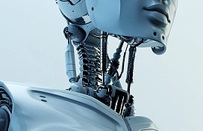
Components of robot
The complex movement of the head
Up, down, left and right.
Delivery and installation - 15 days.
3168 $.

Slide 24
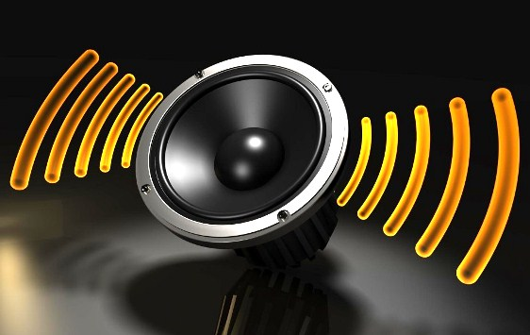
Components of robot
Audio system + Motion Sensor
Includes: MP3 player, USB drive, a 15-watt speakers, motion sensor with sensitivity adjustment from 1 - to 3 meters.
Audio system + motion sensor.
Delivery and installation - 15 days.
2112 $.

Slide 25
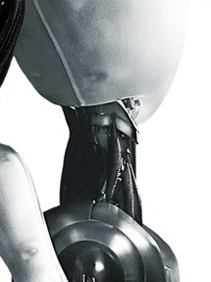
Components of robot
Torso: rotation
Rotation of the corps relative to the legs within 10 degrees.
Delivery and installation - 18 days.
4224 $.

Slide 26
Components of robot
Torso: move forward, backward
Movement of the corps forward, backward relative to the legs within 10 degrees.
Delivery and installation - 18 days.
8800 $.

Slide 27
Components of robot
Torso: forward, backward, and rotation
Movement of the corps forward, backward, and rotation of the corps relative to the legs within 10 degrees.
Delivery and installation - 20 days.
11440 $.

Slide 28
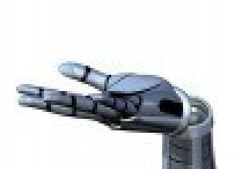
Components of robot
Palms: Up and Down
Palm movement up and down 10 degrees.
Delivery and installation - 12 days.
1408 $.

Slide 29
Components of robot
Palm: rotation
Rotation of hand within 10 degrees.
Delivery and installation - 10 days.
1408 $.

Slide 30
Components of robot
Palm: up and down, and rotate
Rotation of hand within 10 degrees and move up and down 10 degrees.
Delivery and installation - 12 days.
2464 $.

Slide 31
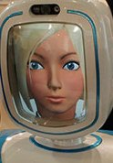
Components of robot
The facial expression on display
Flexible high-resolution display, which can be programmed to simulate facial expressions and speech of the robot.
Delivery and installation - 25 days.
4576 $.

Slide 32
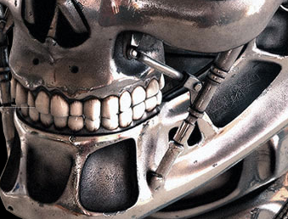
Components of robot
A simple movement of jaws
Simple movement - no sound, no sync.
Delivery and installation - 9 days.
1584 $.

Slide 33
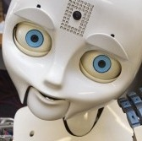
Components of robot
Complex movement of the jaws
Details: jaws move in sync with the sound. Servo motors is integrated in the head for the jaws. Also - MP3 player with 6 GB memory. The kit also includes a 15-watt speakers and remote control. Remote control: play, stop. Play: sequential, random, repeat the same thing.
Delivery and installation - 20 days.
5280 $.

Slide 34
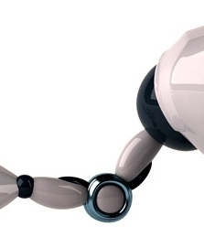
Components of robot
Movement of the arm in the elbow
Hand movement only in the elbow.
Delivery and installation - 15 days.
3168 $.

Slide 35
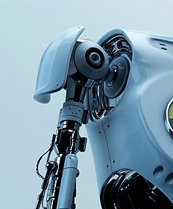
Components of robot
Movement of the arm in the shoulder
Hand movement only in the shoulder.
Delivery and installation - 20 days.
3872 $.

Slide 36
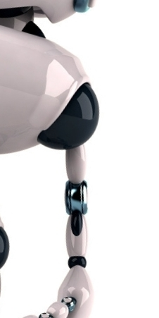
Components of robot
Movement of the arm: the shoulders and elbows
Bending of the arms at the shoulders and elbows.
Delivery and installation - 20 days.
6864 $.

Slide 37
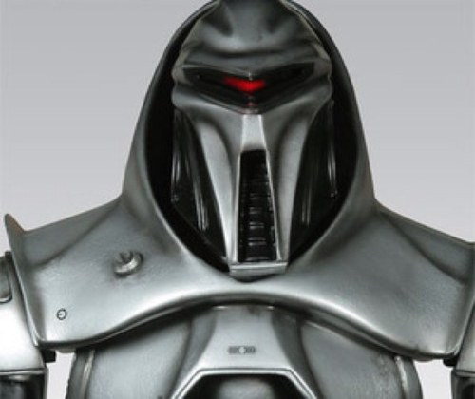
Components of robot
The front lights for Cylon and analogues
Horizontal movement of the red light through the face.
Delivery and installation - 15 days.
1584 $.

Slide 38
Creation of models of robots in human growth (MadScale.com) Retailers: place this offer on your site, redirect orders to us and get 5% of the order value.
We offer an exclusive service, unprecedented on the interior market. In fact, it is a modern sculptural art (mail@madscale.com).
Growth: 180 cm (available higher or shorter).
Weight: 20 kg.
Material: fiberglass.
Assembly takes 10 minutes.
The basic cost refers to hollow and static models.
Period of creation: 1 item - 35 days, 10 - 45 days, 20 - 60 days.
Can be created a model on the layout of the customer.
Cost (it is about quantity of the copies of one robot):
1 robot – 5000$/item, 10 robots – 2800$/item, 20 robots – 2500$/item.

